Slide 1
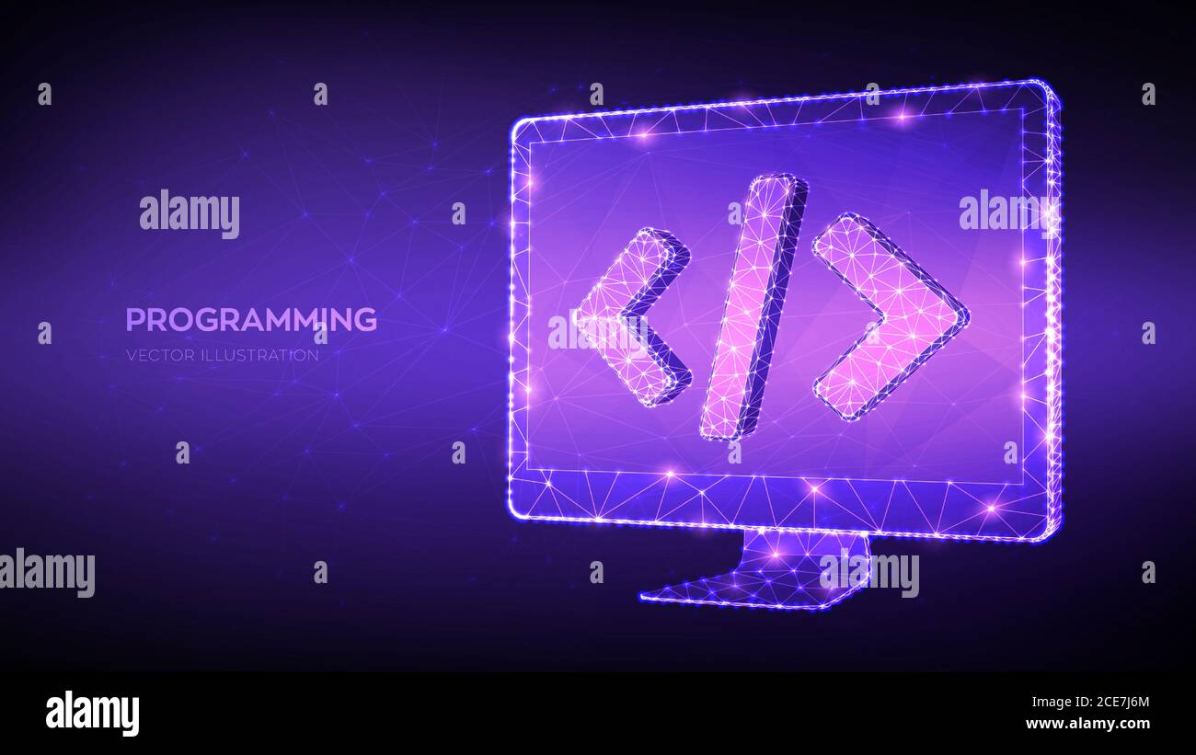



LECTURE TWO • 2026
Software Engineering
Understanding Software Fundamentals & Engineering Principles
Software Development
Process Models
Quality Assurance
MODERN ENGINEERING
2026

Slide 2



What is Software?
A textbook description of software consists of three key components:
1
Instructions
Computer programs that provide desired function and performance
2
Data Structures
Enable programs to adequately manipulate information
3
Documents
Describe the operation and use of the programs
TECHNOLOGY
Software Ecosystem

Slide 3

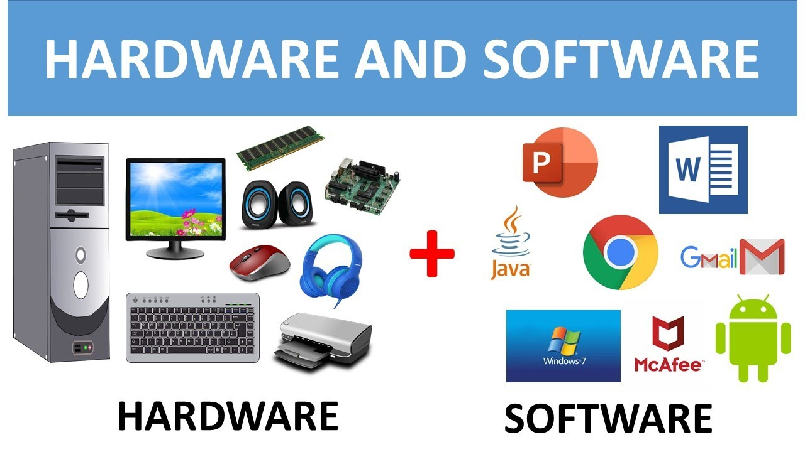





Software Characteristics
Software has characteristics considerably different from hardware:
Logical, Not Physical
Engineered
Developed, not manufactured
A logical system element
Doesn't "Wear Out"
Custom Built
Most software is custom built
No spare parts needed
Every software failure indicates an error in design or in the process through which design was translated into machine executable code.
COMPARISON
Hardware vs Software

Slide 4

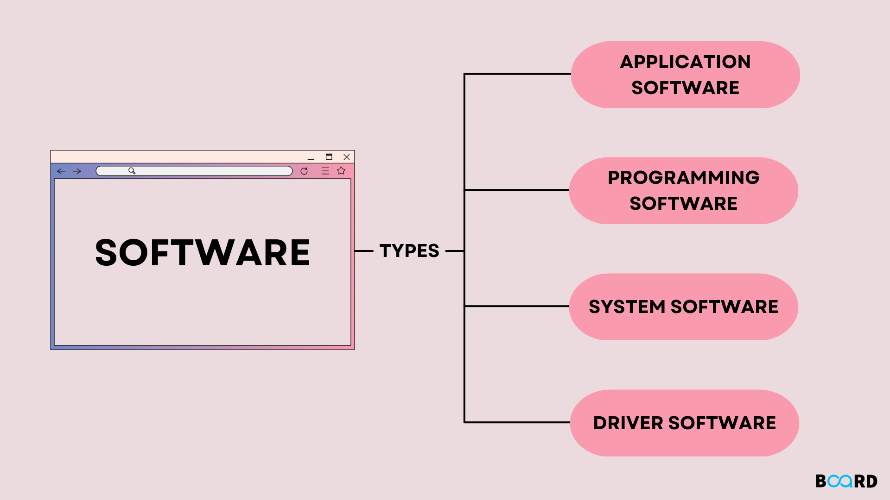





Software Applications — Part 1
Software areas indicate the breadth of potential applications:
System Software
Real-Time Software
Monitors/analyzes/controls real-world events as they occur
Programs that service other programs (compilers, editors, file management utilities)
Business Software
Engineering & Scientific
Largest single software application area for information processing
Characterized by "number crunching" algorithms and computations
CLASSIFICATION
Software Types

Slide 5






Software Applications — Part 2
Embedded Software
PC Software
Word processing, spreadsheets, graphics, multimedia
Intelligent products in consumer and industrial markets
Web-Based Software
AI Software
Non-numerical algorithms for complex problem solving
Web pages with executable instructions (CGI, HTML, Java)
The personal computer software market has burgeoned over the past two decades with hundreds of applications across entertainment, business, and networking.
TECHNOLOGY
AI Software

Slide 6

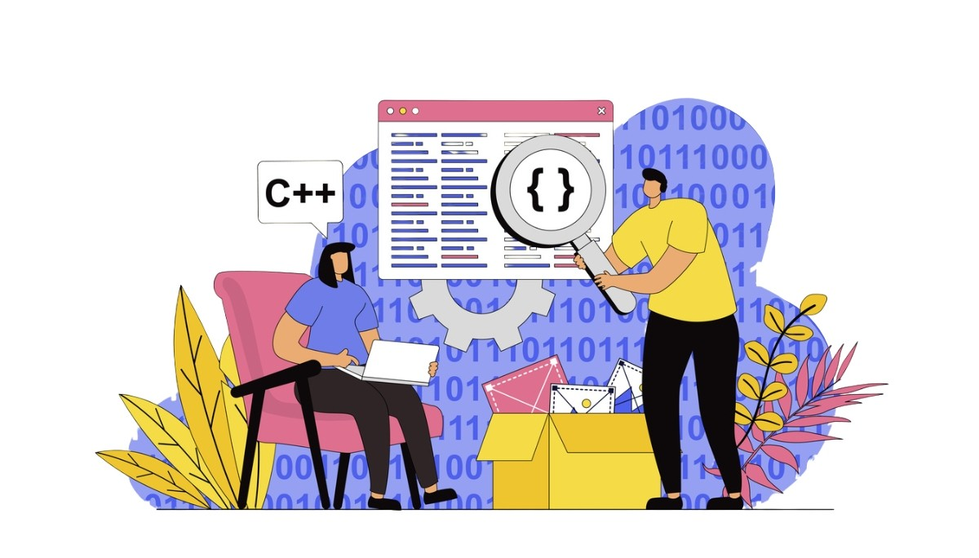




Definitions of Software Engineering
01
The establishment and use of sound engineering principles in order to obtain economically software that is reliable and works efficiently on real machines.
02
The application of a systematic, disciplined, quantifiable approach to the development, operation, and maintenance of software; that is, the application of engineering to software.
Engineering Principles
IN PRACTICE
Systematic
Quantifiable
Software Engineering

Slide 7

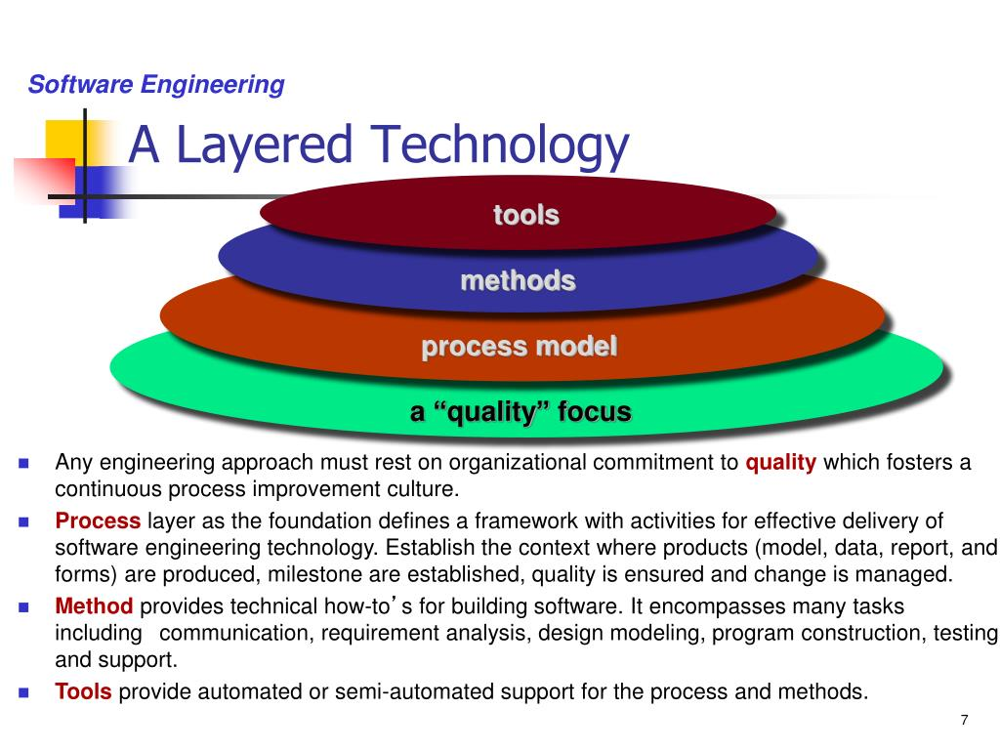




Software Engineering Layers
Software engineering is a layered technology with three essential components:
Process Layer
The foundation — the glue that holds technology layers together and enables rational and timely development
Methods
Provide technical how-to's — requirements analysis, design, construction, testing, and support Software engineering methods rely on a set of basic principles that govern each area of the technology and include modelling activities and other descriptive techniques.
Tools
Provide automated support — integrated tools form computer-aided software engineering When tools are integrated so that information created by one tool can be used by another, a system for the support of software development, called computer-aided software engineering, is established.
ARCHITECTURE
Engineering Layers

Slide 8
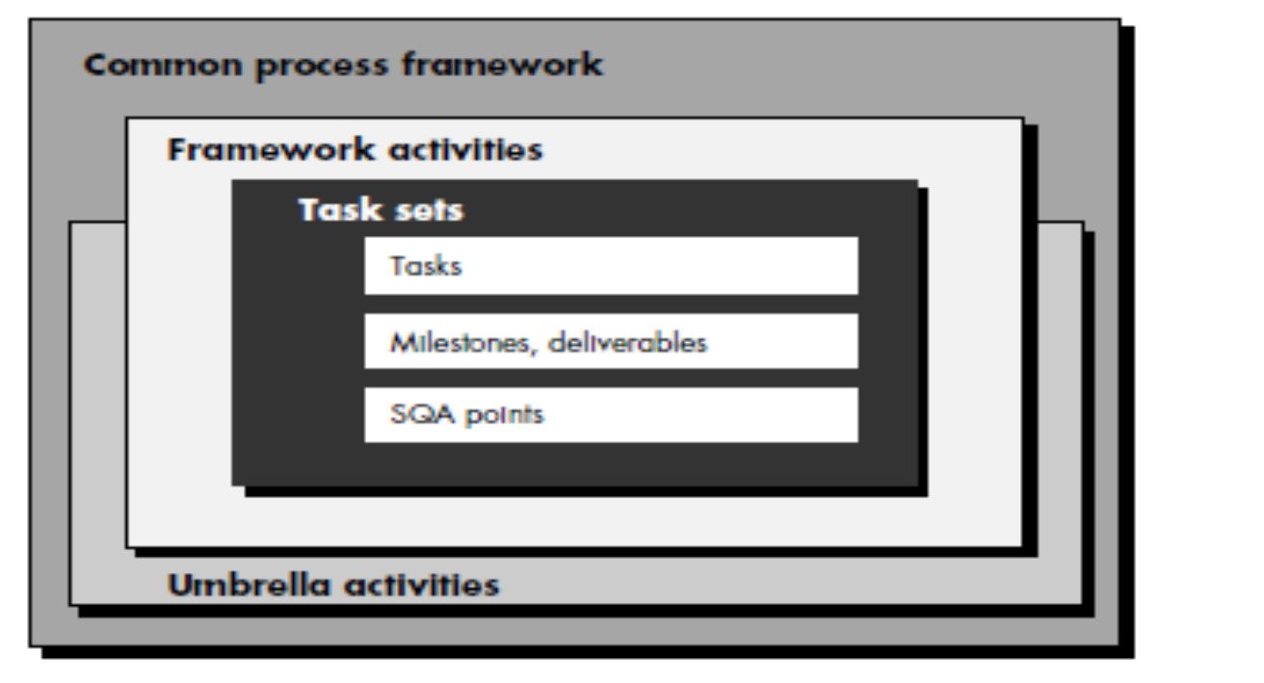
The software process
A common process framework is established by defining a small number of framework activities

Slide 9
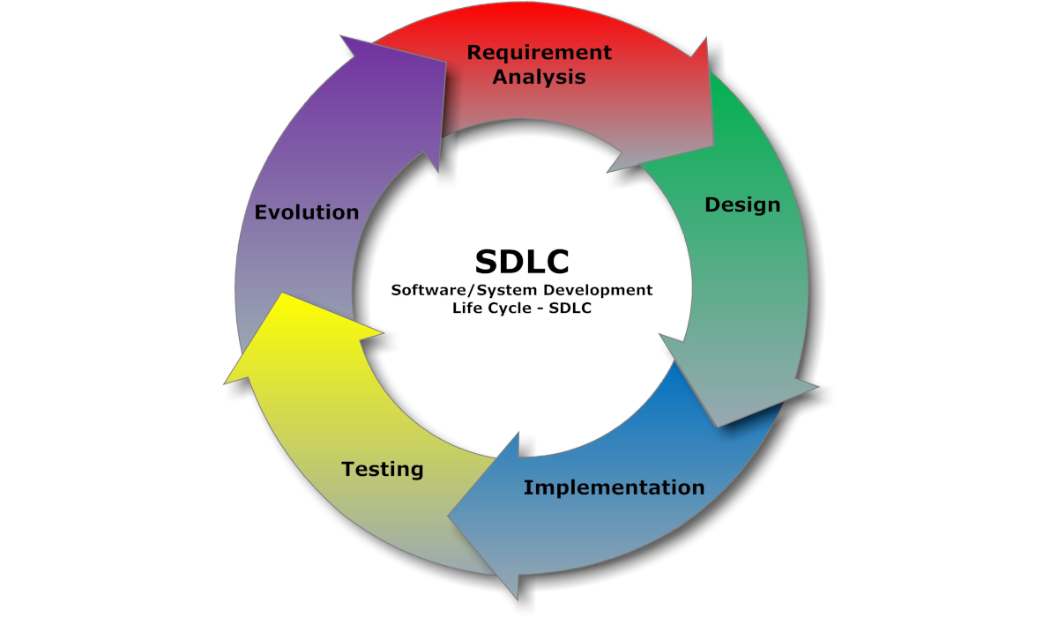






The Software Process
Framework Activities
Applicable to all software projects regardless of size or complexity
Task Sets
Enable adaptation to project characteristics through work tasks, milestones, and quality assurance points
Umbrella Activities
Overlay the process model — quality assurance, configuration management, and measurement occur throughout the process
Quality Assurance
PROCESS MODEL
Configuration
Measurement
Software Lifecycle

